Slide 1
INTRODUCTION TO POWER BI-VISUALIZATION

Slide 2
Visualizations
A visual representation of data is called visualization. It is the Pictorial representation of data. For example, a chart or a graph can be used to represent data visually.
Bar Chart
Line Chart
Map representation
Card visualization
Stacked area chart
Tree map
Pie chart

Slide 3
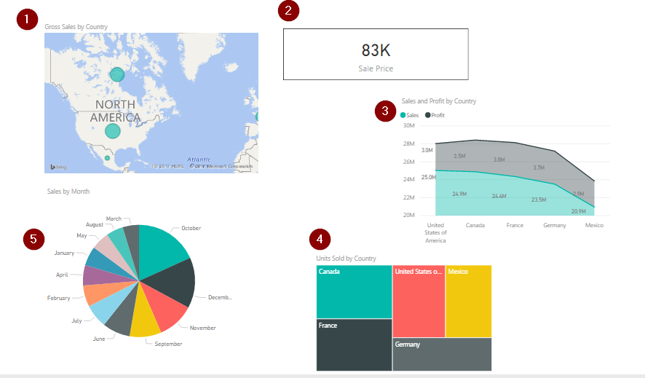

Slide 4
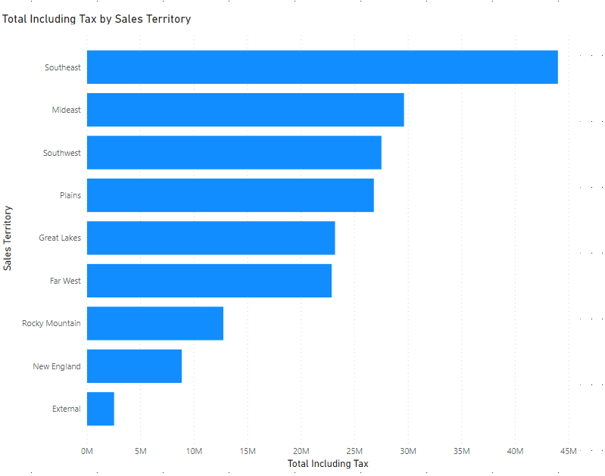
BAR CHART A bar chart is used to represent categorical data in rectangular bars by the length of the rectangle denoted by a specific measure value. The category with the highest measure value has the longest bar whereas the one with the lowest value has the shortest bar. This type of chart is helpful in representing categories mostly as it visualizes only one dimension with a measure.

Slide 5
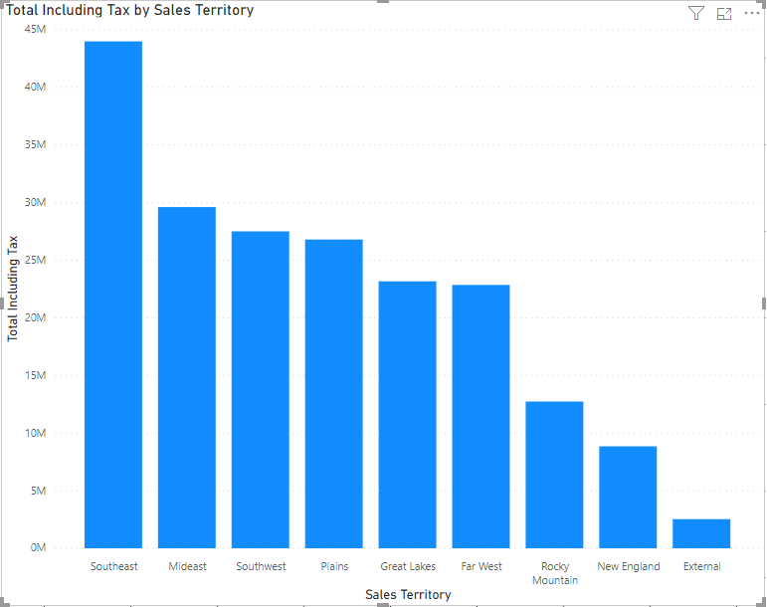
BAR CHARTS

Slide 6
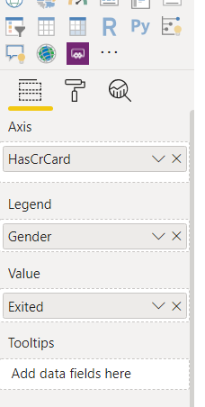
CHARTS DATA BINDINGS & FORMATTING EACH CHARTS CONSISTS OF THE FOLLOWING SECTIONS
FIELDS | FORMATTING | ANALYTICS
The values of fields /columns are binded to the charts as data. Based upon the fields attached to the visualization it will display the values accordingly | The formatting option will change the look and feel of the visualization. For example back color, forecolor, axis labels, titles can be changed using formation options | The Analytics section is used to add different analytics line to the charts like constant line, min line,max line, median line etc.

Slide 7
FIELDS IN CHARTS
AXIS / X-AXIS | VALUE / Y - AXIS | LEGENDS | TOOLTIPS
The Axis is used to represents the Category / X-Axis of the charts. We can have multiple axis. | The value field is used to represent the Y – axis of the charts which is a aggregate value which will be plotted against the x-axis We can have multiple value field. | The legend section is used to break the axis/category. | The Tooltip is the field whose value will be represented while moving the cursor on the charts.

Slide 8
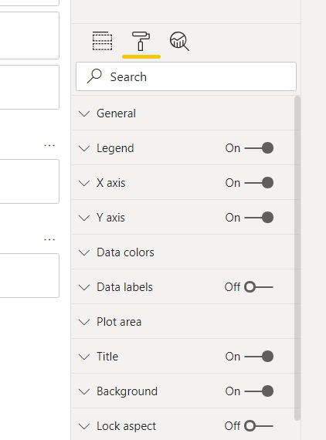
FORMATTING OPTIONS SECTIONS OF FORMATTING IN CHARTS

Slide 9
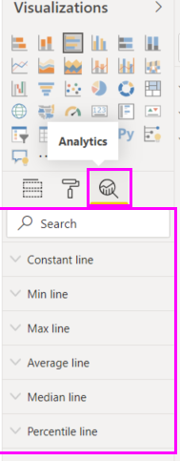
ANALYTICAL OPTIONS OF POWER BI SECTIONS OF ANALYICAL OPTION IN CHARTS

Slide 10
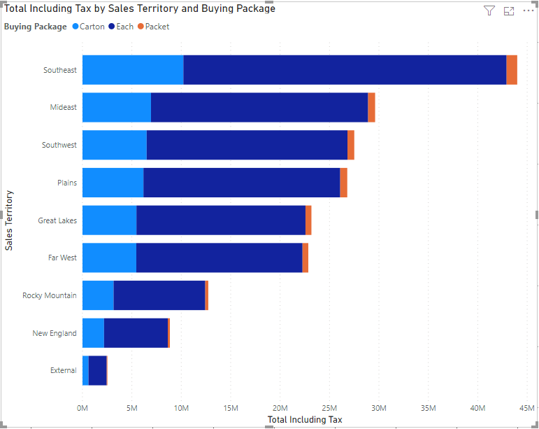
STACK BAR CHARTS This is an extension of the simple bar chart that we saw in the previous sample. In a stacked bar chart, we can introduce two dimensions with a measure as opposed to a single dimension in a simple bar chart. This second dimension can be used to sub-categorize the first dimension along with the measure values. For example, in the figures below we have two dimensions – Sales Territory and Buying Package and a measure Total Including Tax. The second dimension depicts the categorization among how the sales for a particular Sales Territory is divided.

Slide 11
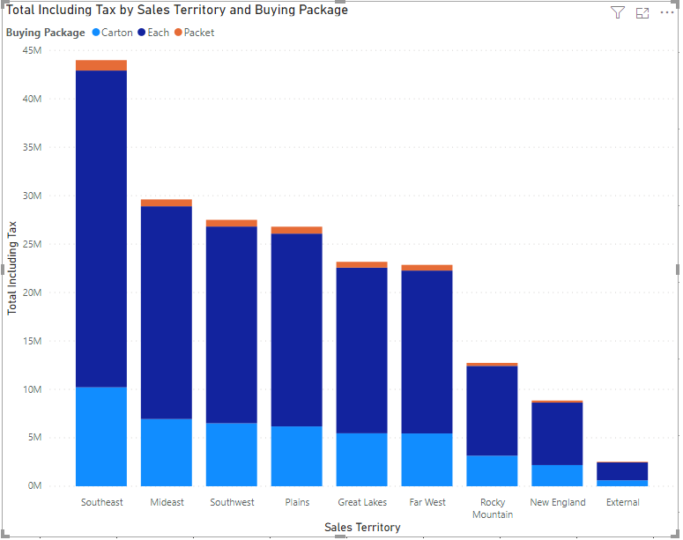
STACK BAR CHARTS

Slide 12
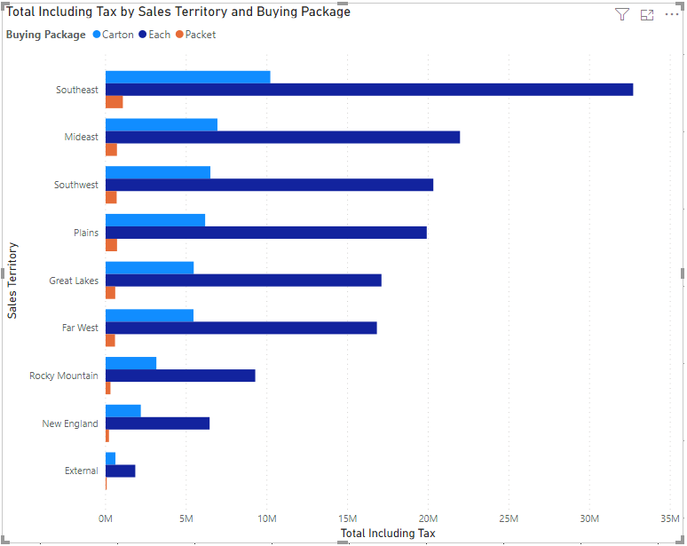
CLUSTERED BAR CHARTS The clustered bar chart is almost similar to the stacked bar chart except for the fact that it groups the second dimension by the first and then displays the chart. It is useful if you want to visualize a sub-group within a group by a measure. .

Slide 13
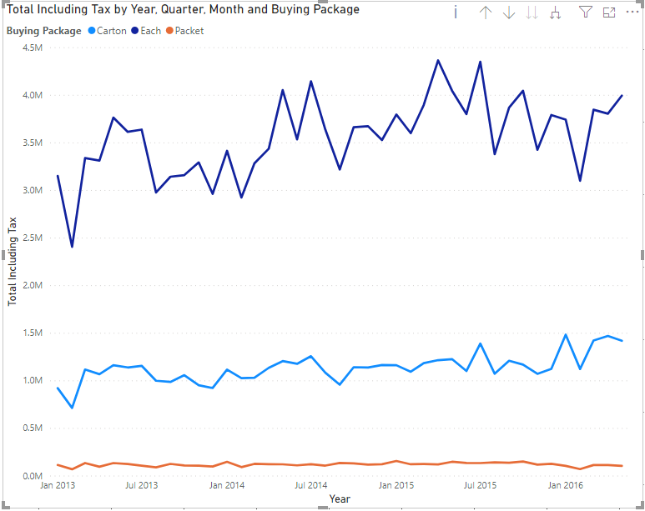
LINE CHARTS The line chart is another important and frequently used chart types in Power BI. These types of charts are used to define a trend over a period of time. Usually, it is not recommended to use any other dimension other than the dates along the X-axis. This gives the reader an impression of the moving value across the time period. A line chart in Power BI can have one or two dimensions. With a single dimension, a single line will be plotted along the time, whereas if a second dimension is introduced, a line for each of the values of the second dimension will be plotted on the graph. .

Slide 14
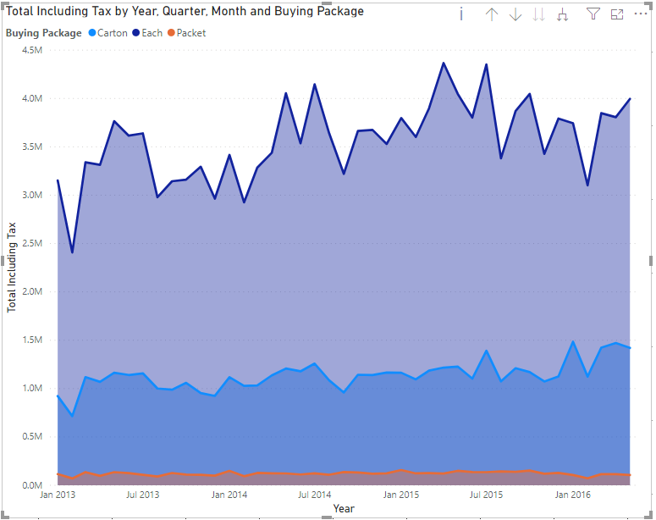
AREA CHARTS An Area Chart can be considered as an extension of the line chart that we came across in the previous example. In this chart, the line and the area underneath are color-coded such that it is easier for the reader to make some comparisons among the different dimension members. An area chart can be built using one dimension or two. If it is created using two dimensions, then dimensions are displayed on top of one another. Such an area chart can be called a stacked area chart. .

Slide 15
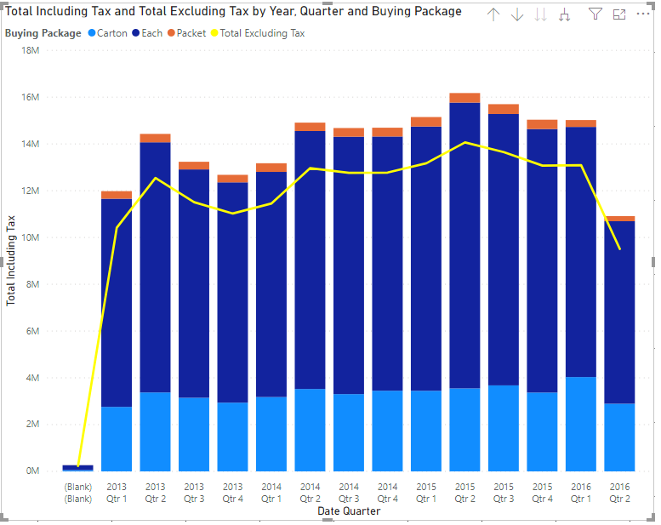
COMB0 CHARTS Combo chart as the name suggests is a combination of both bar and line chart in a single visual. This is helpful when visualizing categorical data along with two measured values. In a combo chart, usually, we keep a single dimension that can be represented by two measures. One measure will be represented by the length of the bars whereas the second measure will be denoted by the line. We can also make a stacked combo chart by introducing a second dimension which will sub-categorize the first dimension like in a stacked bar chart. .

Slide 16
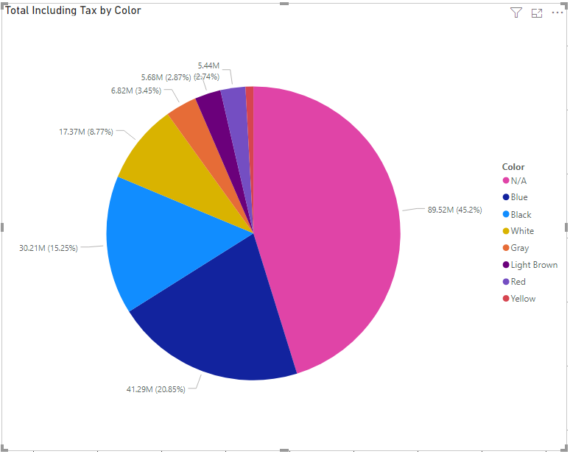
PIE CHARTS A pie chart is another most commonly used chart types in Power BI. It is used to understand the proportion of a dimension relative to the other members of the same dimension. The proportion is calculated by a measured value which calculates the area in percentage and allocates to each of the members. Pie charts are useful if the dimension has 5-6 members only to visualize. If there are more members in the dimension, then the pie chart becomes much cluttered and loses readability. .

Slide 17
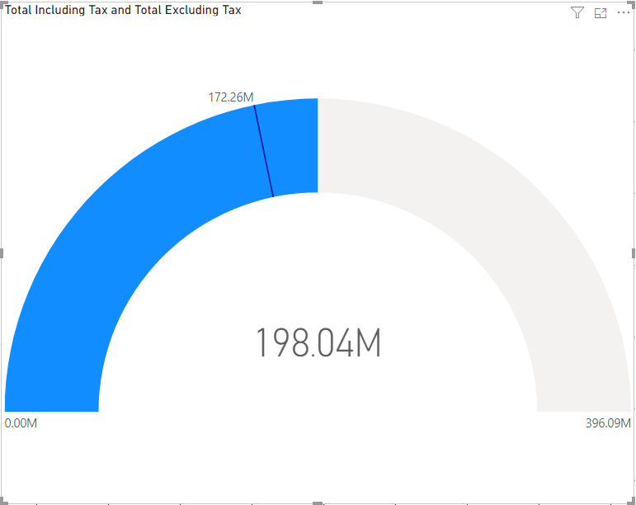
GAUGE A gauge in Power BI is used to calculate the performance of a specific measurement based on some goals. It is used to represent the health of a specific measure or the current status of a KPI. A needle is used in the chart to represent the goal and the colored gauge represents the current status of the measure, whether the goal has been reached or not. The current measurement value is also displayed in the figures just below the gauge. .

Slide 18
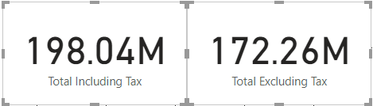
CARD Cards are a simple visual where the value of the measure is displayed. Also known as the big number of tiles in Power BI, these are extremely used to provide a one-time glance at the value of a certain measure. For example, cards can be used to learn about Total Sales or Total Profit in a year, etc. .

Slide 19
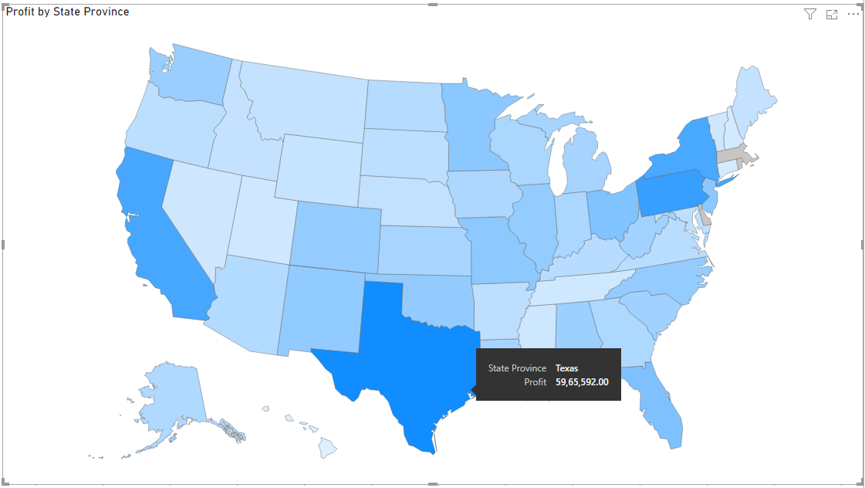
MAPS Maps are another important type of chart used in Power BI. These charts are used to represent geographical data directly on the maps which become very intuitive and easy to understand for the readers. Maps in Power BI can be automatically created from the values in the dimensions. For example, if the dataset contains cities or states, the Power BI engine is capable to extract the information and plot those on the maps. Alternatively, there is also a provision to provide latitude and longitude values to plot the cities on the maps. .

Slide 20
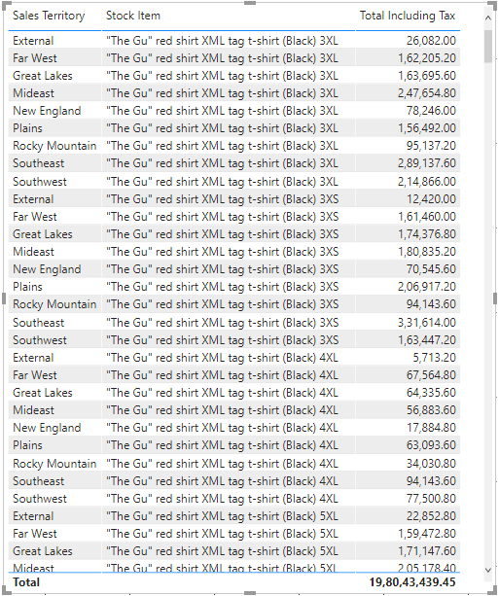
TABLE Last but not least, of course, tables are the best when it comes to visualizing a set of records by rows in a tabular format. To whatever extent, modern a dashboard might look, when it comes to detailed information, tables work the best for any kind of analysis. .

Slide 21
THANK YOU References https://www.sqlshack.com/an-overview-of-chart-types-in-power-bi/

Slide 22
Questions On which scenarios which charts are used ? https://www.arbelatech.com/insights/white-papers/zero-to-beautiful-choosing-charts-for-data-visualization

